Slide 1
The Role of the School Counselor in Suicide Prevention, Assessment, and Intervention
By: Dr. Henry and Kayla Newkirk, Clinical Mental Health Counseling Intern

Slide 2
DISCLAIMER
This presentation is not to replace any medical or mental health treatment, assessment or diagnoses.
It is to provide information only.

Slide 3
Objectives:
Statistics
Facts versus Myths about Suicide
Risk Factors, Warning Signs, and Protective Factors
Suicide Prevention Strategies
Suicide Assessment
Suicide Intervention/Response
Local and National Resources

Slide 4
Statistics

Slide 5
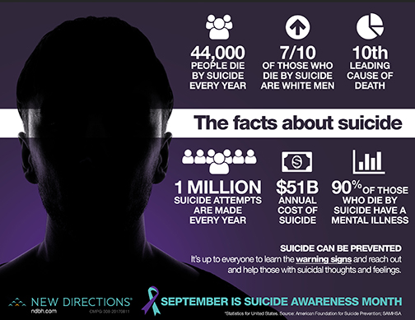

Slide 6
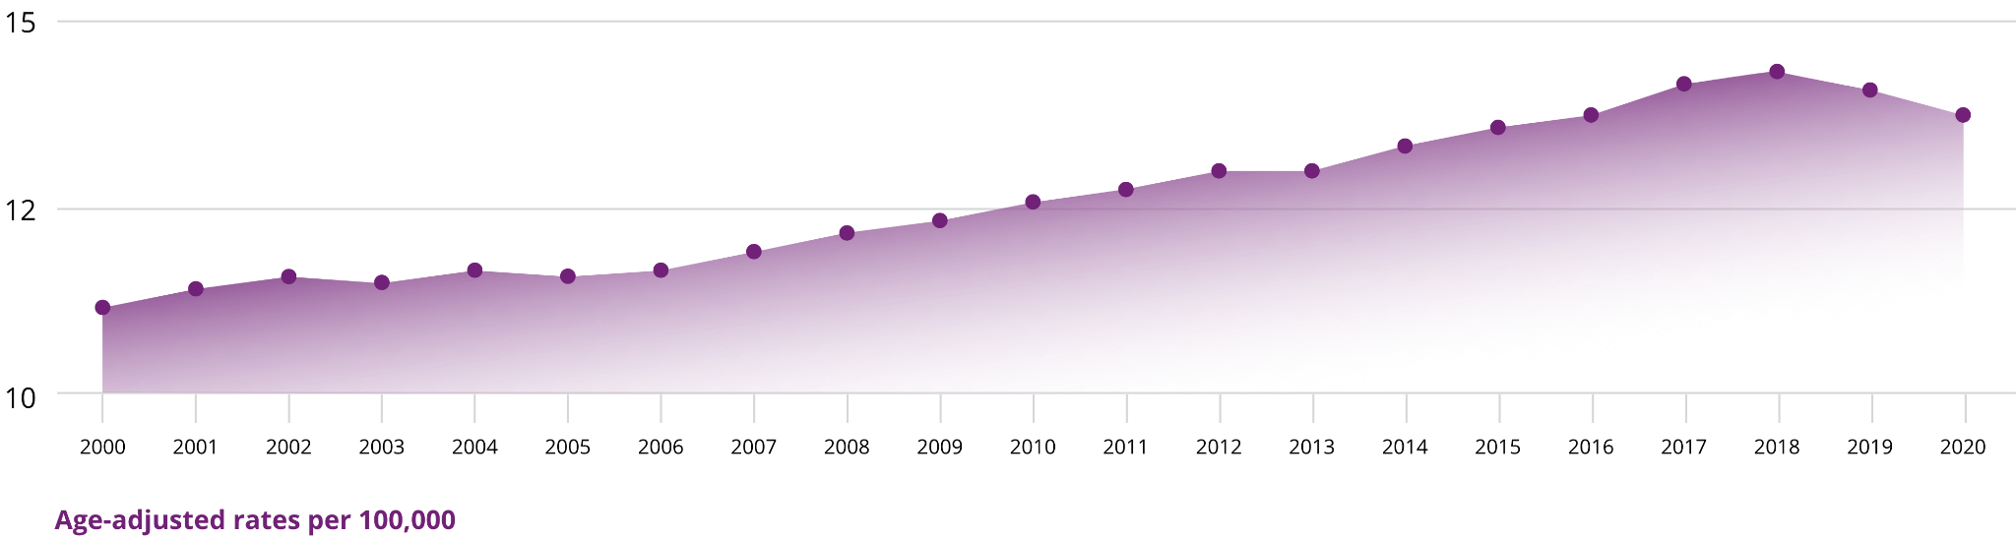
Suicide Rates 2000-2020
Suicide Data and Statistics | Suicide | CDC

Slide 7

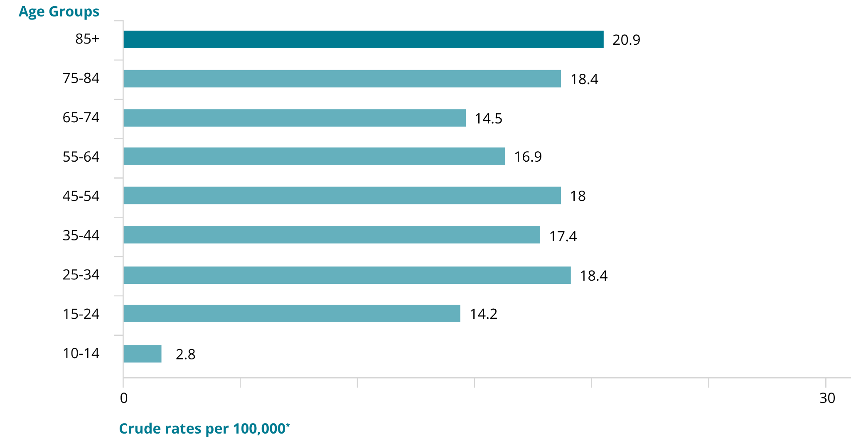
Suicide Rates 2000-2020
Suicide Data and Statistics | Suicide | CDC

Slide 8

Rates per age group 2020
Suicide Data and Statistics | Suicide | CDC

Slide 9
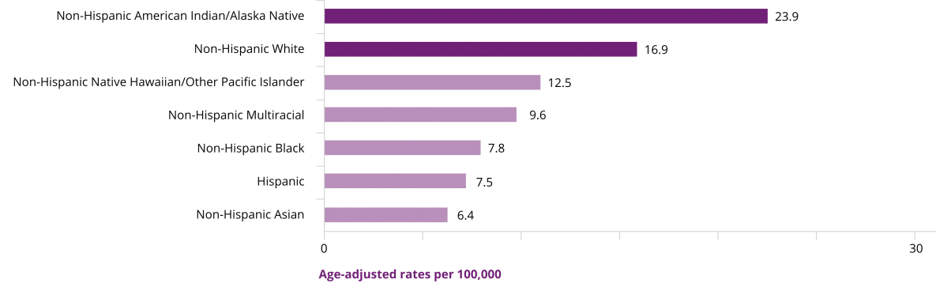
Rates for suicide based on ethnicity
Suicide Data and Statistics | Suicide | CDC

Slide 10
Facts about Suicide in Younger Populations in 2010
38,364 individuals in America died by suicide
That is 1.6% of deaths in America for that year
Individuals between the ages 10-24 years of age completed 4,876 or 12.6% of those deaths by suicide.
Mental health concerns affect up to 20% of the adolescent population

Slide 11
Myths about Suicide

Slide 12
People who talk about it won’t do it
Talking about it increases the chances the person will act on it
People who talk about it are attention seeking
Suicide can’t be prevented
People who take their own lives are weak
Teenagers and college students are at the highest risk for suicide
Suicide always occurs without warning

Slide 13
Risk Factors

Slide 14
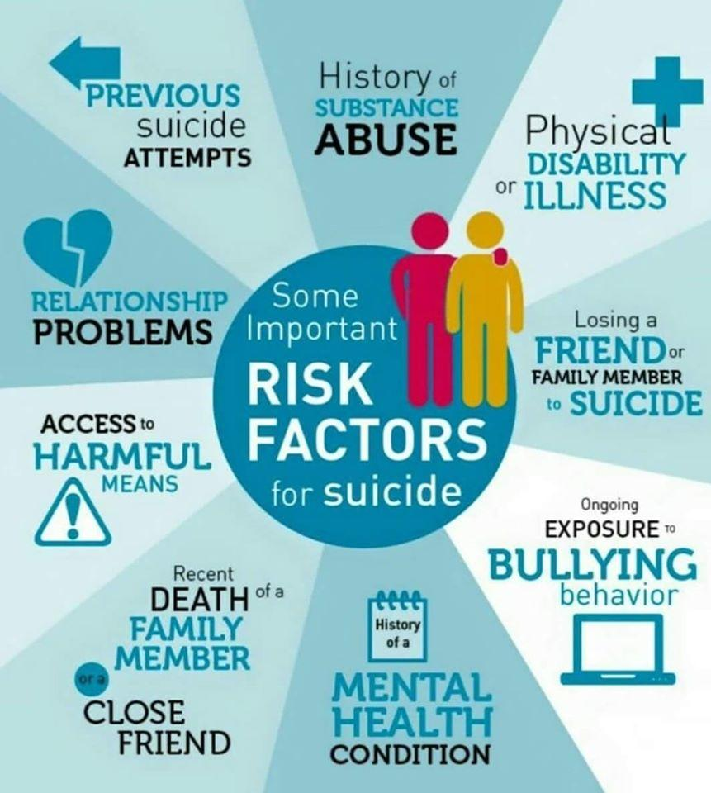

Slide 15
Ethnicity
Gender
Involvement in Bullying
Mental Health Disorders
Family History of Suicide and Mental Health Disorders
Sexual Orientation
Feelings of Social Isolation
Situational Factors i.e.: breakup with significant other, embarrassment at school, unwanted pregnancy, etc.
Legal Problems
Loss or Death of a Loved One
Lack of Basic Needs Being Met

Slide 16
Warning Signs

Slide 17
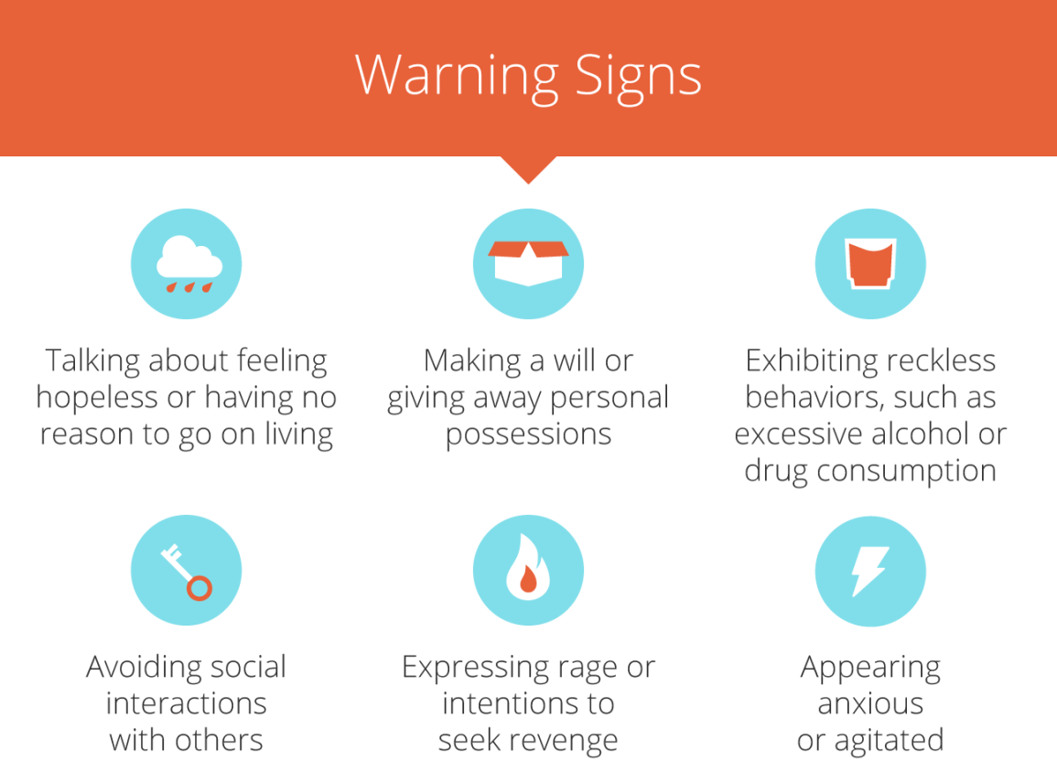

Slide 18
Protective Factors

Slide 19
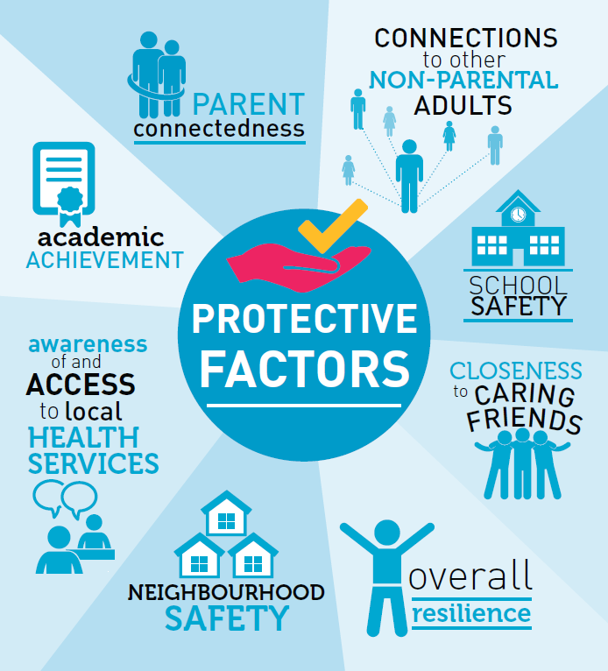

Slide 20
Suicide Prevention

Slide 21
Goals of Suicide Prevention
1. Utilize a multitiered model to assist many populations including:
Students that are at low-risk, moderate-risk, have current thoughts or have previously attempted, and those who are at a high-risk with a current plan, have intent, and means to the plan
2. The goals of this model include:
Assist students who are at risk with information and referrals to help with prevention and treatment
The second goal is to reduce risk factors for students

Slide 22
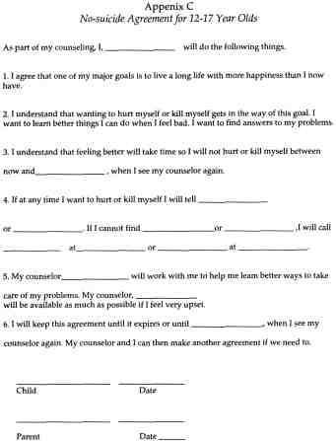
Safety Planning: No Harm Contracts
Creating a “no harm contract” with students to help them with little support needed and helps them with a strengths-based approach
This is a safety plan that is created with students and their families and includes:
An emergency contact
Coping skills
Goals
Hopeful statements that they create to assist them in the future as needed
These steps should be documented and even signed by the student to ensure that they are aware of their plan and can use it with their school counselor
Notes:
This is not a permanent solution to suicide prevention, but is used as a tool to help students see the strengths they have including supports

Slide 23
Cramer et. al 10 Core Competencies for Suicide Prevention
1. Acknowledge and maintain reactions and attitudes when discussing suicide with a student
2. Built rapport, collaboration, and empathy with students during these conversations
3. Ensure knowledge upon evidence-based risks and protective measures
4. Be sure to keep focus on the current plan, intent, and possible access to suicidal ideation
5. Determine the level of possible risk
6. Continue working through the conversation by creating a collaborative and evidence-based treatment plan
7. Contact supportive individuals and supporters
8. Create proper documentation such as the risk, plan, and motivation behind treatment and ethical decision-making
9. Go over laws in place regarding suicide
10. Properly debrief and ensure self-care measures are followed

Slide 24
Suicide Risk Assessment Strategies

Slide 25
Engage in self-awareness activities including:
Reflection and Journaling:
Regularly note feelings, thoughts, and reactions to challenging situations.
Identify patterns in one's responses to stress and trauma.
Mindfulness and Meditation:
Daily practice can enhance emotional awareness and regulation.
Grounding exercises can help counselors stay present in challenging moments.
Professional Supervision:
Seek guidance and feedback from experienced colleagues.
Discuss complex cases to gain different perspectives.
Personal Therapy:
Process personal emotions and reactions away from the workplace.
Ensure personal traumas don’t influence professional judgment.
Continuous Education:
Attend workshops on self-awareness, emotional intelligence, and burnout prevention.
Keep updated on best practices for personal well-being.
Peer Support Groups:
Share experiences with fellow counselors.
Learn coping strategies and gain emotional support.
Self-Assessment Tools:
Use tools like the Emotional Intelligence Scale, Myers-Briggs, etc., to gain insights.
Understand strengths and areas of growth.
Establish Boundaries:
Clearly define work-life balance.
Take regular breaks, ensure adequate sleep, and engage in leisure activities.

Slide 26
Pros and Cons of Prevention Strategies
Pros
Cons
Holistic Understanding: Prevention strategies allow counselors to understand the student's environment, including their family, school, and peer dynamics.
Early Intervention: Detection of early signs and risk factors can lead to timely intervention, reducing the risk of escalation.
Awareness and Education: School-wide prevention programs can increase awareness among students, making them more likely to seek help or support their peers.
Creates a Supportive Environment: By promoting open dialogue, it reduces stigma and encourages students to share their feelings.
Resource Allocation: Schools can prioritize resources (like counseling staff and support groups) based on identified needs.
False Positives/Negatives: Assessments might mistakenly categorize some students as at risk, causing unnecessary concern or intervention, or miss some who are genuinely at risk.
Stigma: Despite best efforts, discussing suicide might inadvertently lead to stigma around mental health, deterring some students from seeking help.
Lack of Follow-up: Schools may not have the resources for long-term support for students identified as at risk.
Dependence on Reporting: Relies heavily on students' willingness to report their feelings or concerns about peers. Some students might underreport due to fear, stigma, or misunderstanding.
Training Variability: The effectiveness of gatekeeper models or other prevention strategies can vary depending on the quality and consistency of training.

Slide 27
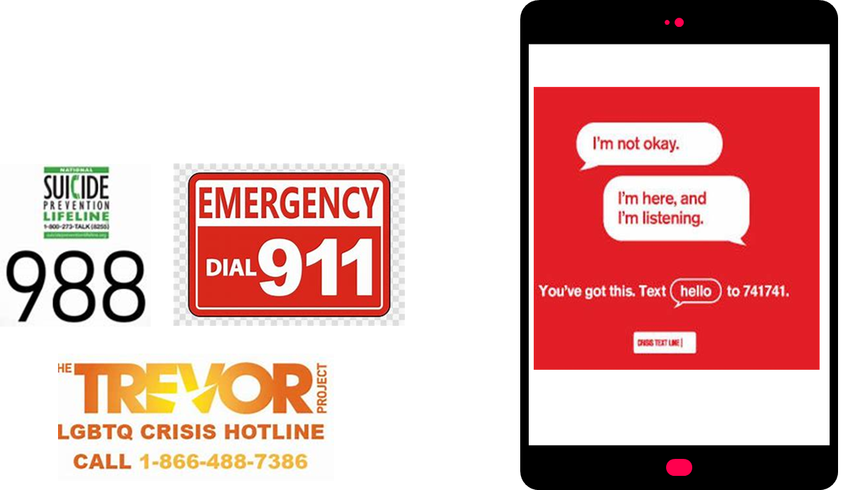
Suicide Prevention Support

Slide 28




Where do I find mental health support after the crisis?
User Psychology Today
Use 211
Contact your insurance company for benefit information/list of providers
Check with your employer for EAP information
Start making calls and sending emails

Slide 29
Resources
Gallo, L., & Morris, C. a. W. (2022). Suicide intervention in schools: If not school counselors, then who? Teaching and Supervision in Counseling. https://doi.org/10.7290/tsc043z3v
Hyatt, K. (n.d.). Suicide Prevention Strategies [Slide show; PowerPoint Presentation].
Suicide prevention. (n.d.). Student Support Services - Lennox School District. https://www.lennox.k12.ca.us/apps/pages/suicideprevention
Witte, R. H., & Mosley-Howard, G. S. (2015). Mental health practice in today’s schools: Issues and Interventions.

